Slide 1
Using Single Sign-On (SSO) with Office Add-ins
Implement Single Sign-On (SSO) for Office Add-ins-

Slide 2

Implement Single Sign-On (SSO) for Office Add-ins-
Office Add-ins, SSO, and Microsoft Graph
Call Microsoft Graph from the client-side code

Slide 3
Office Add-ins & Microsoft Graph
Office Add-ins can use SSO to call Microsoft Graph
Add-ins first trigger the Office client to obtain the bootstrap token with getAccessToken()
Bootstrap token exchanged with Azure AD for an access token used to call Microsoft Graph

Slide 4
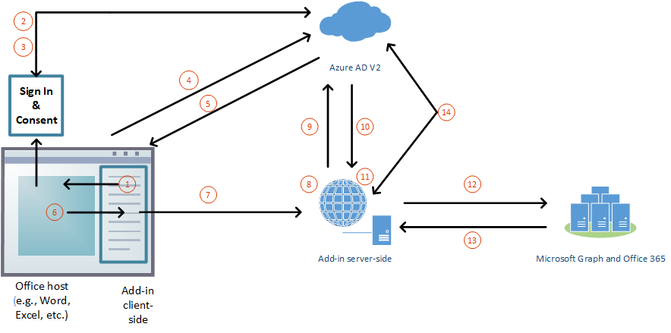
Office Add-ins, SSO & Microsoft Graph Authentication Flow
Notes:
1. If the user isn't signed in, the Office client application opens a pop-up window for the user to sign in.
2. If this is the first time the current user has used your add-in, they're prompted to consent.
3. The Office client application requests the bootstrap access token from the Azure AD v2.0 endpoint for the current user.
4. Azure AD returns the bootstrap token to the Office client application.
5. The Office client application sends the bootstrap access token to the add-in as part of the result object returned by the `getAccessToken()` call.
6. JavaScript in the add-in makes an HTTP request to a web API that is hosted at the same fully qualified domain as the add-in, and it includes the bootstrap access token as proof of authorization.
7. Server-side code validates the received bootstrap access token.
8. Server-side code uses the OAuth2 "on behalf of" flow to obtain an access token for Microsoft Graph in exchange for the bootstrap access token.
9. Azure AD returns the access token to Microsoft Graph, *and a refresh token, if the add-in requests **offline_access** permission*, to the add-in.
10. Server-side code caches the access token to Microsoft Graph.
11. Server-side code makes requests to Microsoft Graph and includes the access token to Microsoft Graph.
12. Microsoft Graph returns data to the add-in, which can pass it on to the add-in's UI.
13. When the access token to Microsoft Graph expires, the server-side code can use its refresh token to get a new access token to Microsoft Graph.

Slide 5
Office & Microsoft Graph
Office clients are limited in prompting for user consent to the OpenID profile permission
Office clients can’t prompt user for consent to Microsoft Graph permissions
If user hasn’t consented to Microsoft Graph permission, when the bootstrap token is exchanged for an access token, Azure AD returns the error: AADSTS65001 When your add-in receives this error code, it should gracefully handle the scenario with a fallback authorization system
Launch popup dialog to prompt the user to consent to Microsoft Graph permissions
Fail fast with getAccessToken({ forMSGraphAccess: true})

Slide 6
Call Microsoft Graph from the client-side code
const sso = require("office-addin-sso");
// ...
let bootstrapToken =
await OfficeRuntime.auth.getAccessToken(
{
allowSignInPrompt: true
});
let exchangeResponse =
await sso.getGraphToken(bootstrapToken);
// get profile data
const response =
await sso.makeGraphApiCall(
exchangeResponse.access_token
);
// control the request
const endpoint = "/me/messages";
const urlParams = "?$select=receivedDateTime,subject,isRead&
$orderby=receivedDateTime&$top=10";
const response = await
sso.getGraphData(exchangeResponse.access_token,
endpoint,
urlParams);
Start by obtaining the bootstrap token by asking for the hosting Office application to authenticate the user
Exchange the bootstrap token with Azure AD for an access token that can be used to call Microsoft Graph
Retrieve the user’s profile data using the makeGraphApiCall() method
Take full control over the Microsoft Graph request with the getGraphData(token, endpoint, urlParams) method

Slide 7
Ensure errors are handled with a fallback authorization system
const fallbackAuthHelper =
require("./fallbackAuthHelper");
// ...
try {
// 1. get bootstrap token
// 2. exch bootstrap token for access token
// 3. call Microsoft Graph
} catch (ex) {
if (ex.code) {
if (sso.handleClientSideErrors(ex)) {
fallbackAuthHelper.dialogFallback();
}
} else {
sso.showMessage(
"EXCEPTION: " + JSON.stringify(ex)
);
}
}
Your code should monitor all stages for exceptions
Specific exceptions and error codes indicate authorization should fallback to another process
Use this to prompt the user for consent to Microsoft Graph permissions
Detect & handle rare instances where the bootstrap token is valid when received, but expired when exchanged for the access token

Slide 8
Demo

Slide 9

Summary
Office Add-ins, SSO, and Microsoft Graph
Call Microsoft Graph from the client-side code

Slide 10
Reading further
Office Add-ins documentation
https://docs.microsoft.com/office/dev/add-ins/
Overview of authentication & authorization in Office Add-ins
https://docs.microsoft.com/office/dev/add-ins/develop/overview-authn-authz
Enabling single sign-on for Office Add-ins
https://docs.microsoft.com/office/dev/add-ins/develop/sso-in-office-add-ins
Authorize to Microsoft Graph with SSO
https://docs.microsoft.com/office/dev/add-ins/develop/authorize-to-microsoft-graph

Slide 11
Thank you

